Slide 1
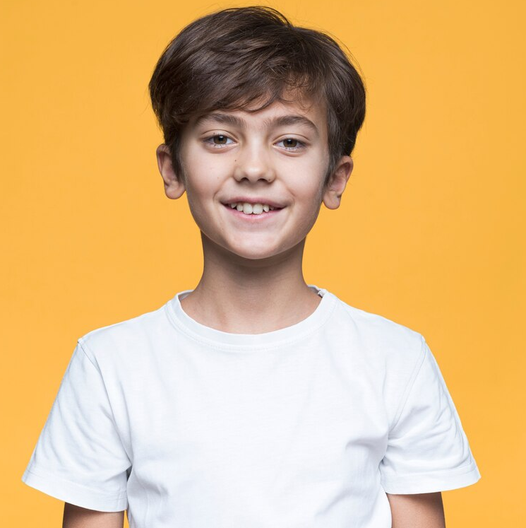
“I hope to become an engineer when I grow up to make a positive impact on the world”
Add image that represents this persona
Goals
I need to be an engineer
To help the world
I need to learn programming
Frustrations
I don’t love complex learning
I hate boring learning method
Kareem Hassan
Age:
Hometown:
Family:
12
Vancouver, Canada
his parents and younger sister
Kareem Hassan, a 12-year-old from Vancouver, Canada, is a curious and adventurous outdoor enthusiast who also enjoys tinkering with gadgets and dreams of becoming an engineer to make a positive impact on the world.

